Slide 1
Sri Sairam College of Engineering, Bengaluru
Dept of Computer Science A Project on NECK MOVEMENT CONTROLLED WHEELCHAIR USING IOT
Silla De-Ruedas
Presented by :
Shivashankar
(1SB15CS076)
Under the Guidance of
Dr.B.Shadaksharappa
Vice Principal
Hod Dept of CSE.
Mr. T.K. Pradeep Kumar
Assistant Professor
Dept of CSE
SSCE

Slide 2
CONTENTS
Abstract
Introduction
Literature Survey
Existing System
Proposed system
System Requirements
System Architecture
System Designs
Implementation
Results
Conclusion and Future Enhancement
References

Slide 3
ABSTRACT
Wheelchair can extend the lives of many disabled people. For handicapped people human found a wheel chair which can be moved by using hands for those who don’t have legs.
But the peoples who don’t have legs as well as hands cannot move their wheel chair by themselves. There has to be a care taker to look after the person at all time.
Our wheel chair is moved by neck movement to over come above situation.

Slide 4
INTRODUCTION
Electric Wheelchairs extend the capabilities to partial handicapped people.
The first records of wheeled seats being used for transporting disabled people date to three centuries later in China .Chinese used early wheelbarrows to move people as well as heavy objects.
Generally people who use are: Lower limb disabled people, Patients at the hospitals, etc.
Some researcher has an attempt to develop other techniques for controlling electrical wheelchair using joystick.
The electric wheelchairs which are controlled using a joystick controlled system which cannot be used by the disable people so we come up with the innovative idea as head movement system

Slide 5
LITERATURE SURVEY
Sl no | Author | Title | Advantages | Disadvantage
1 | Roger Achkar , Gaby AbouHaidar , Hasan Dourgham , DaniSemaan. | Mobile Controlled Wheelchair | Helps to locate their wheelchair's position. provides the user with the ability to control the wheelchair even when sitting on it. | If mobile is the case then the people who lost there hands cannot use that.
2 | Rajesh Kannan Megalingam, Sarath Sreekanth. | Wireless gesture controlled wheelchair | Bluetooth-based wheelchair are controlled by finger or hand gesture using an Android application. | Bluetooth has some quite small range and here also hands are required

Slide 6
LITERATURE SURVEY CONTD…..
Sl no | Author | Title | Advantages | Disadvantage
3 | Nutthanan Wanluk , Sarinporn Visitsattapongse. | Smart wheelchair based on eye tracking | smart wheelchair based on eye tracking which is designed . The motion of eyeball is also used as the cursor control on screen to control the appliance and send message to smart phone. | The motion of the eye ball is a tedious thing it creates irritation and discomfort.
4 | R. Josephine Leela , A. Joshi, B. Agasthiya | Android Based Automated Wheelchair Control | The handicapped person gives their voice to the android mobile, output of the Android mobile is voice command that is converted into text. | The patients who have lost there voice cannot use this even if there is small voice change the device cannot be used.

Slide 7
LITERATURE SURVEY CONTD…..
Sl no | Author | Title | Advantages | Disadvantage
5 | Deepesh K Rathore, Pulkit Srivastava, Sankalp Pandey | A novel multipurpose smart wheelchair | The system contains a navigation pad which can be held in hand. | The navigation pad costs more and more over hands are required.
6 | Arys Carrasquilla-Batista, Karolquirós-Espinoza, Carlagómez-carrasquilla | An Internet of Things (IoT) application to control a wheelchair through EEG signal processing | The system uses the Brainwave Headset of NeuroSky, where the EEG raw signal is processed | Any involvement involving with neuro technology is extreme dangerous.

Slide 8
EXISTING SYSTEM
Some researcher has an attempt to develop techniques for controlling wheelchair such are :
[1] eye control system
[2] voice controlled system
[3] joystick controlled system
DISADVANTAGES
Squint and abnormality eyes in persons
Voice pollution
System is completely controlled by hands

Slide 9
PROPOSED SYSTEM
The person who is operating the wheelchair will be equipped with a device using RFID technology which is placed around the neck of the person which is helpful to move the chair.
The project uses 2 geared motors of 60RPM to drive the prototype of the wheel chair.
We are using the IoT technology to interface the modules. We are also using four switches in the circuit which will be ON when the person will move neck forward and backward. This project uses BCM2835 as its controller.

Slide 10
ADVANTAGES
It is easy to access for the disabled peoples.
It is one time investment for the real life application and a bit advanced and comfortable to use.
They are durable, adjustable and feature special seats with soft pads for orthopedic patients.
Our system can be used in residential areas and rural areas.

Slide 11
SYSTEM REQUIREMENTS
Software Requirements
- Arduino Compiler
- IOT app
Hardware Requirements
-Accelerometer
-BCM 2835
- RFID Tag wireless
- Heart Beat and BP Sensor
- WIFI Modules
- Motors
- Wheelchair

Slide 12
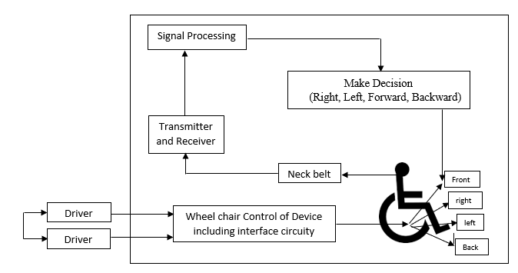
SYSTEM ARCHITECTURE

Slide 13
USE CASE DIAGRAM

Slide 14
DATAFLOW DIAGRAM

Slide 15
SEQUENCE DIAGRAM

Slide 16
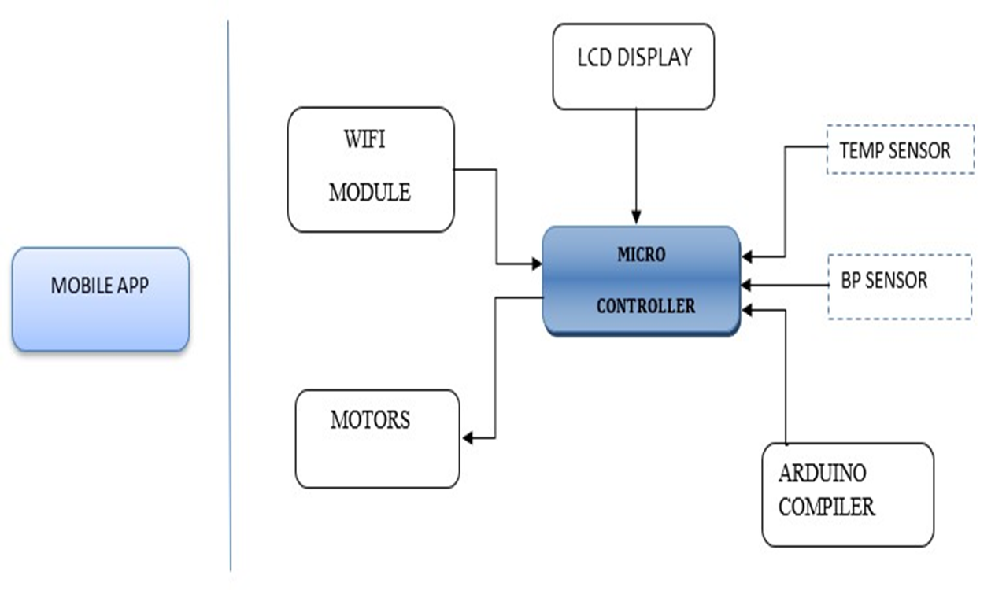
SYSTEM DESIGN

Slide 17
Module 1 Communication between neck belt and controller. Module 2 Working and dealing within the board. Module 3 Communication between the controller and motor.
IMPLEMENTATION

Slide 18
Communication between neck belt and controller
MODULE - 1
As soon as power is supplied the RFID reader will send the signal to tag.
Uses radio waves to automatically identifying and tracking of object.
RFID tags which is placed in neck belt will return the feedback signal to the controller.

Slide 19
Working and dealing within the board
MODULE - 2
Controller is used to send the signal to the Arduino compiler to compile the program
Once the program is compiled ,the signal is sent back to microcontroller.

Slide 20
Communication between the controller and the motor
MODULE - 3
Controller will send the signal to the motor.
A motor driver is a little current amplifier.
The function of motor drivers is to take a low-current control signal and then turn it into a higher-current signal that can drive a motor.

Slide 21
RESULTS
Our wheel chair can be completely controlled by neck belt.
We can monitor room temperature and pulse rate

Slide 22
CONCLUSION
It is one time investment for the real life application and a bit advanced and comfortable to use.
They are durable, adjustable and feature special seats with soft pads for orthopedic patients.

Slide 23
FUTURE ENHANCEMENT
To make it stop if suddenly obstacle is detected.
To apply the database storage to store all data of patient

Slide 24
REFERENCES
[1] Vasundhara, G. Posugade, Komal K. Shedge, Chaitali S.Tikhe (2012) “Touch Screen Based Wheelchair System”, International Journal Of Engineering Research and Applications, Volume 2, Issue 2, Mar-Apr-2012.
[2] Jayesh, K.Kokate, A.M.Agarkar (2014) “Voice operated wheelchair”,International Journal of research in engineering and technology, Volume 3,Issue 2, Feb-2014.
[3] Tuck-Voon How, Rosalie H Wang and Alex Mihailidis (2013) “Evaluation of an intelligent wheelchair system for older adults with cognitive impairments”, Journal of Neuro Engineering and Rehabilitation 2013.
[4] Pramila Kupkar, Prajakta Pandit, Nikita Dhamdhere, P.P Jadhav (2016) “Android Controlled wheelchair”, Intelligent Control and Information Processing (ICICIP), Imperial Journal of Interdisciplinary Research (IJIR) Vol-2, Issue-6,2016

Slide 25
REFERENCES CONTD….
[5] P.Suthal, S. Prabhu, A. Stephen Paul (2013) “Multi Technology Based Controller for Wheelchair Locomotion", International Journal of Engineering and Innovative Technology (IJEIT) Volume 2, Issue 12, June 2013.
[6] Archana Hula, Rekha Bandage, Pratik Shah, Rashmi Mahajan (2015) “android based application for wireless control of wheelchair”, International journal of research in Engineering and Technology (IJRET), Vol-4, Issue- Apr, 2015.
[7] www.slideshare.net/androidcontrolledwheelchair.pdf
[8] Technology. (2013, Oct. 01, 2013). iBOT 4000 mobility system without fold-flat-seating user manual. Available: http://www.ibotnow.com/ manuals_without_foldflat.html

Slide 26
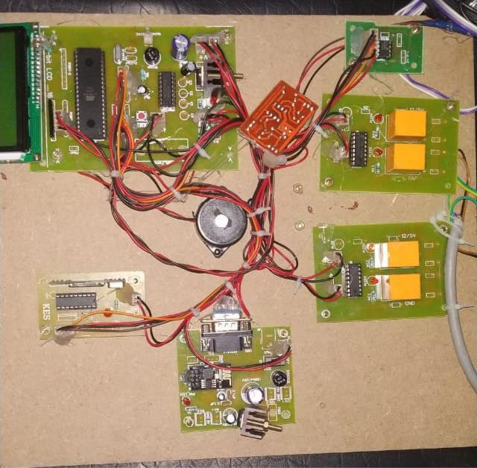
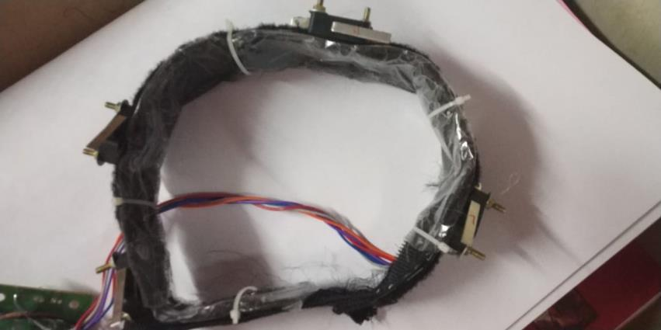
SNAPSHOTS

Slide 27
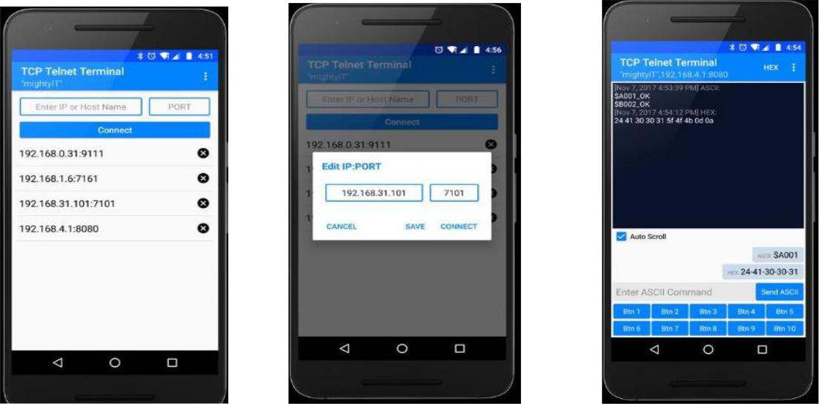


Slide 28
